Slide 1
Service RDC Rollout
Limited Launch
Friday March 15th 2013

Slide 2
Agenda
Supply Chain Initiatives
SVC RDC Project Goals
Current State
Future State
Program Schedule
Roles & Responsibilities
Q&A Session

Slide 3
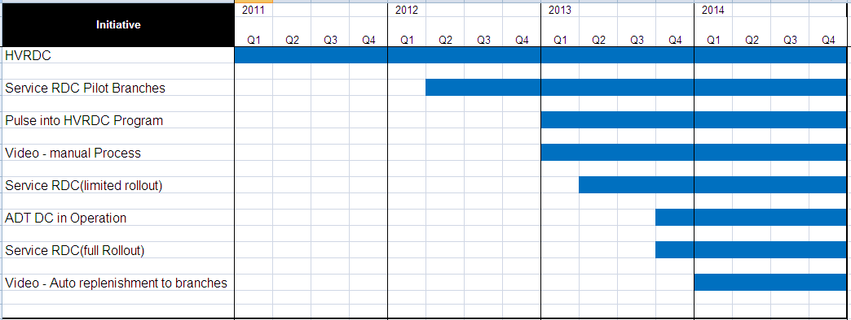
Supply Chain Initiatives
Supply Chain Replenishment Optimization complete Q1 2014!

Slide 4
Participating Branches

Slide 5
Project Goals
Problem Statement
Goals
Today, our branches individually own and maintain inventory in to support the Service business. Each Branch is tasked with Inventory Management, Planning and Material Handling.
Small, irregular shipments from multiple suppliers result in excessive freight costs. .
Less than optimal inventory accuracy rates makes it difficult to implement systematic solutions to improve operating performance.
Eliminate the need for branch inventory and associated management
Deliver centralized demand and inventory planning competency and an automated service truck replenishment process
Establish a platform for growth that will be scalable across all ADT branches
Benefits
Reduced branch material handling functions
Lower Operating Costs by reducing freight spend
Inventory reduction by reducing branch safety stock and right-sizing truck inventory
Properly plan Service truck inventory

Slide 6
Current State
Branches order product using the min-max process for the RDCRM location
Multiple Shipments from Multiple Suppliers into Branches with no delivery consistency
Small opportunities for shipment consolidation
Unknown deliveries at branch from supplier base
Material Handlers/Supply Chain Coordinators distribute parts to Service Technicians as needed or via the Oracle Truck replenishment report.

Slide 7
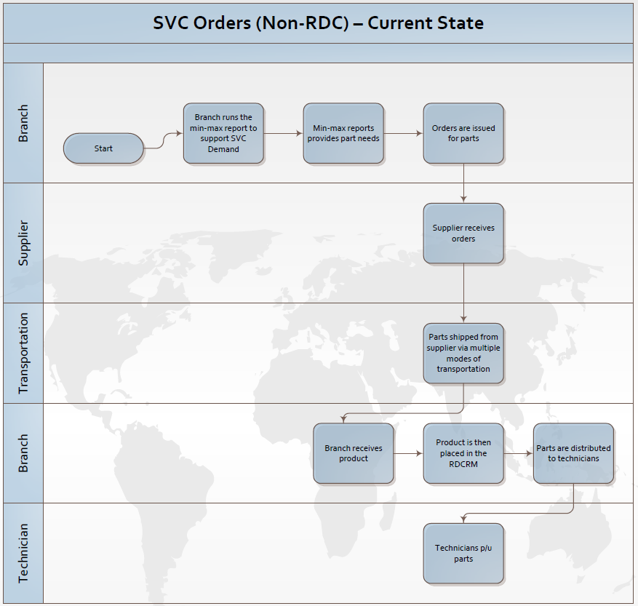
Current State

Slide 8
Future State
Technician Pick up replenishment kits once a week
Branches delivered Critical & Slow moving parts once a week
Weekly shipments of Tech Replenishment Kit from closest proximity DC lowers transportation costs and improves service levels
Consolidation of Tech Kits into a branch allows for freight mode shift to lower cost LTL shipments
Predictable delivery schedules with consistent service and supply levels executed to support customer base
Branch Sub level Changes
RDCRM – Automated
SO001 – Manual
Why?
The purpose of these changes are to align all branches with a uniform replenishment process
RDCRM will function as the primary location for Automated RDC parts
SO location will support one-off needs & Video support

Slide 9
Future State

Slide 10
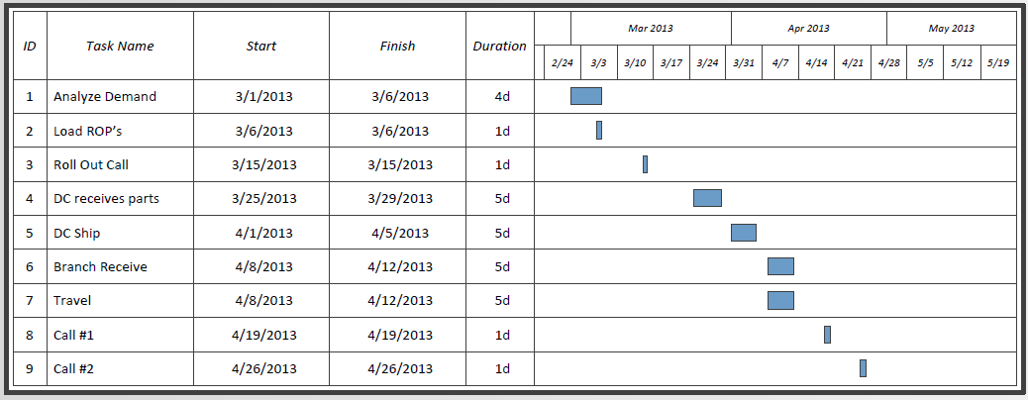

Program Schedule

Slide 11
Next Steps: Roles & Responsibility
Branches
Material Handler – Receive, sort & distribute orders. Process weekly Min-Max report.
Service Team Manager – Provide information downstream to technicians (i.e. Process, status updates etc..)
Operations Support Team Manager – Support program (Process overview)
Area Operations Manager – Escalation of any issues
Supply Chain
Ryan Mark – Demand planning ownership (min-max levels; stocking availability/support)
Ryan Mark – Monitor Pilot progress; capture data; Coordinate weekly team meetings
Dave Lund – Operations Support; Feedback on challenges & process improvements
Eric Blue – Pilot feedback ; Opportunities & improvements; Escalation of issues
RDC Planning Team – Provide support on any Branch request / Changes
Distribution Center
DC Operations – Order support; Picking & packing of Pilot orders

Slide 12

Questions

